Slide 1

UNIVERSITY INSTITUTE OF ENGINEERING
COMPUTER SCIENCE ENGINEERING
Bachelor of Engineering (Computer Science & Engineering)
Subject Name: Internet of Things (IoT)
Subject Code: 20CST357
INTRODUCTION TO IOT
DISCOVER . LEARN . EMPOWER

Slide 2
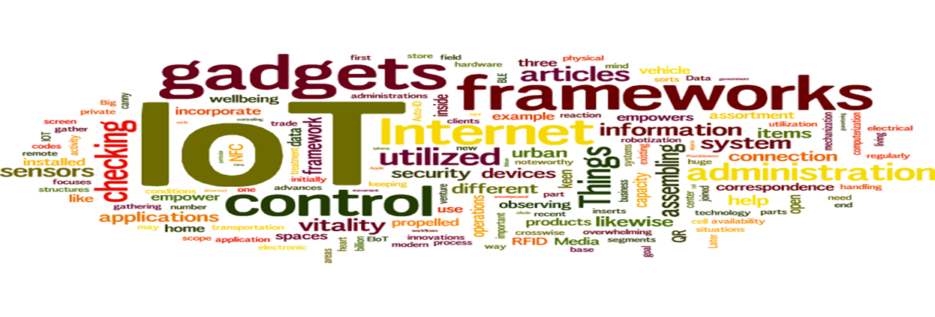
Internet of Things
Course Outcomes:
1. Analyze the basic terminologies associated with IoT and use it.
2. Justify the applications of internet of things and correlate them.
3. Compare different objects and communication strategies and also able to see the issues raised by communication strategies in IoT.
4. Examine the protocols required for communication and packet size required for each application.
5. Illustrate security issues with IoT like security, privacy, communication standard and some other legal issues.

Slide 3
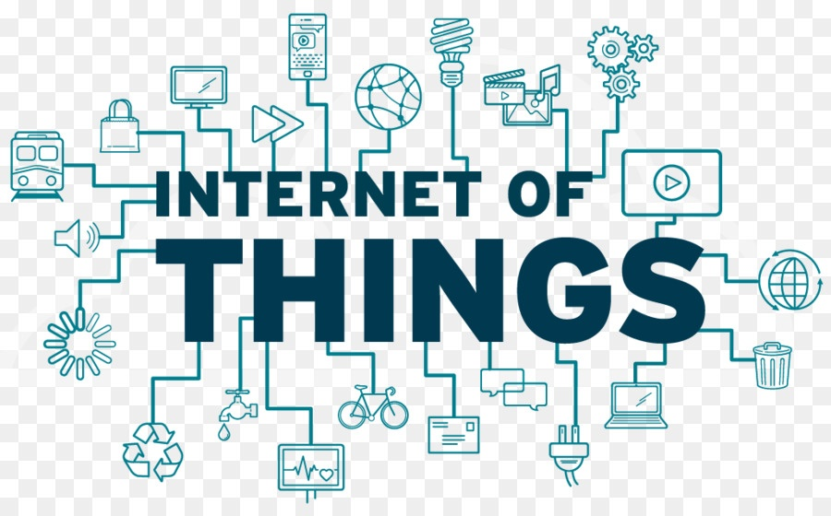
Internet of Things
Definition of IOT.
Historical Background.
Components of IOT.
Why IOT?
IOT Technologies
Practical Applications
Challenges
Future of IOT

Slide 4
Introduction to IoT (CO1)
The Internet of Things (IoT) is an arrangement of interrelated processing gadgets, mechanical and advanced machines, items, creatures or individuals that are furnished with exceptional identifiers and the capacity to move information over a system without expecting human-to-human or human-to-PC communication. The Internet of Things is really a truly straightforward idea, it means taking every one of the things on the planet and associating them to the web.
The Internet of Things is simply "A network of Internet connected objects able to collect and exchange data."
In a simple way to put it, You have "things" that sense and collect data and send it to the internet. This data can be accessible by other "things" too.

Slide 5
Historical Background (CO1)
In mid 1982 the idea of the system of shrewd gadgets was talked about, with an adjusted Coke machine. This coke machine is adjusted at "Carnegie Mellon University" and turning into the primary Internet-associated apparatus. This machine had the option to report its stock and whether recently stacked beverages were cold.
In 1994 Reza Raji clarified the possibility of IoT as "little parcels of information to an enormous arrangement of hubs, to coordinate and mechanize everything from home machines to whole processing plants". After that numerous organizations proposed different arrangements like Microsoft's at Work or Novell's Nest. Bill Joy proposed Device to Device (D2D) correspondence as a piece of his "Six Webs" structures at the World Economic Forum at Davos in 1999.
The idea of Internet of Things originally wound up mainstream in 1999. English business visionary Kevin Ashton initially utilized the term Internet of Things in 1999 while working at Auto-ID labs. Other than that close field correspondence, standardized identification scanners, QR code scanners and computerized watermarking are the different gadgets which are taking a shot at IoT in the present situation.

Slide 6
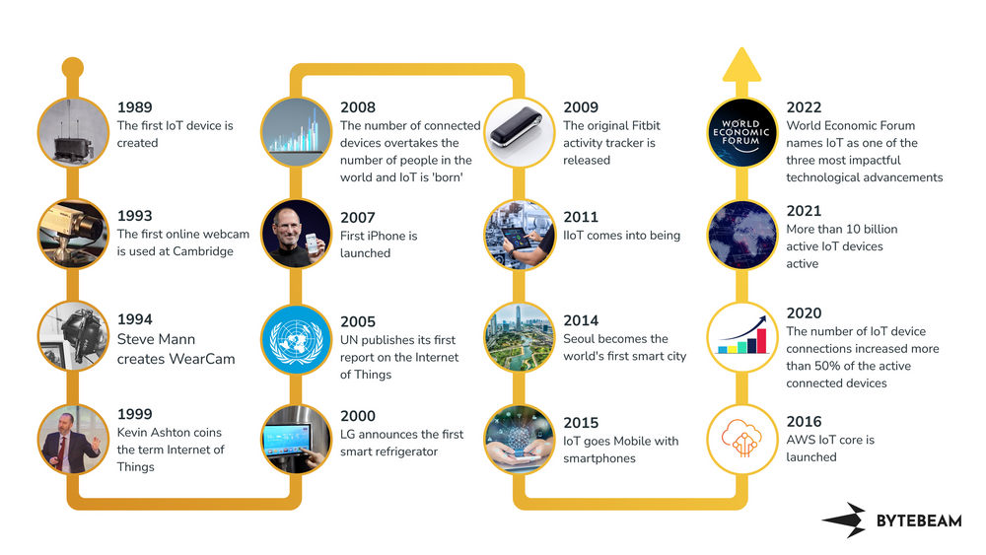

Slide 7
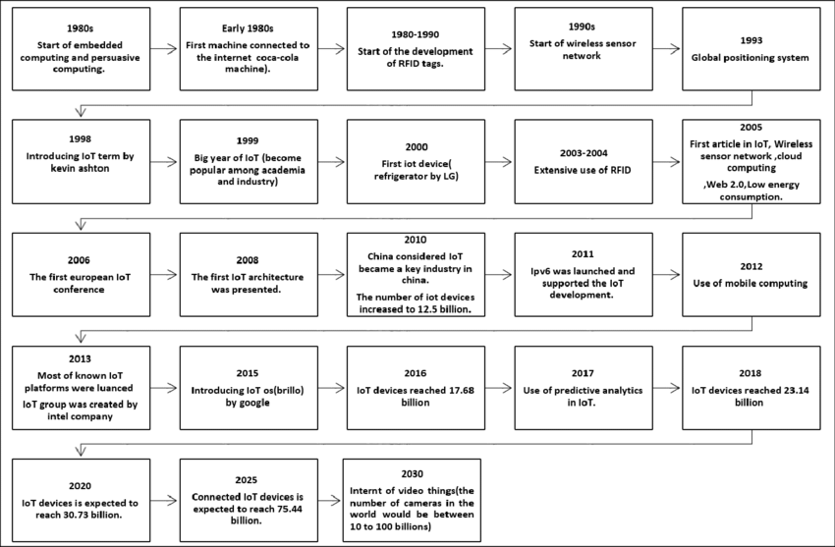

Slide 8
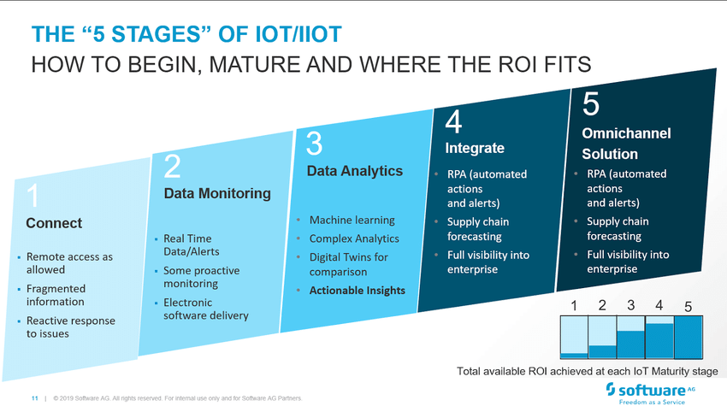

Slide 9
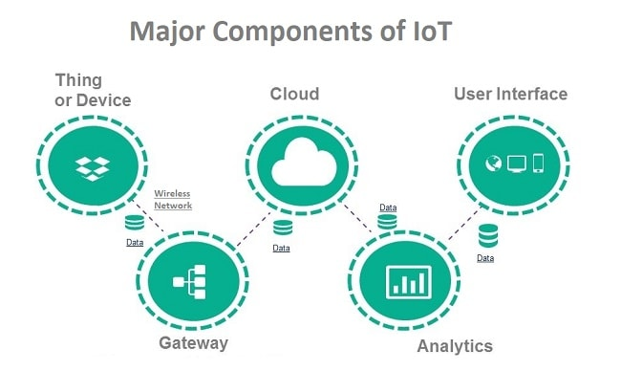
Components of IoT (CO1)

Slide 10
Why IoT? (CO1)
Dynamic control of industry and daily life.
Improve the resource utilization ratio.
Integrating human society and physical system.
Flexible configuration
Acts as technology integrator.
Universal inter-networking.

Slide 11
Practical Applications (CO2)
Smart Homes
Wearables
Connected Cars
Industrial Internet
Smart cities
Smart retail
Energy engagement
Agriculture and Farming
Healthcare

Slide 12
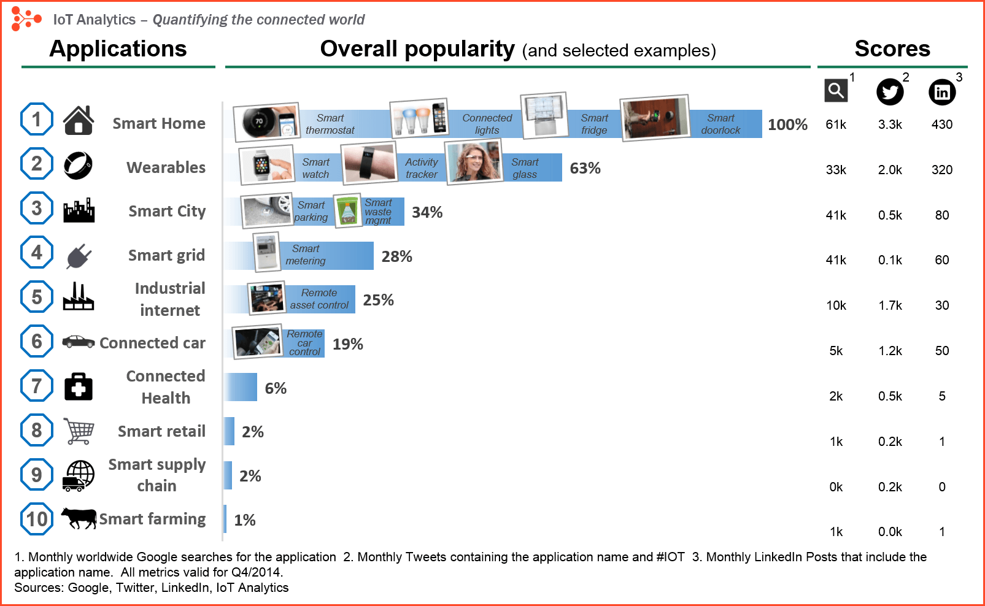

Slide 13
Challenges (CO2)
Meeting customer expectations
Easing security concerns
Keeping IoT hardware updated
Overcoming connectivity issue
Waiting for government regulation

Slide 14
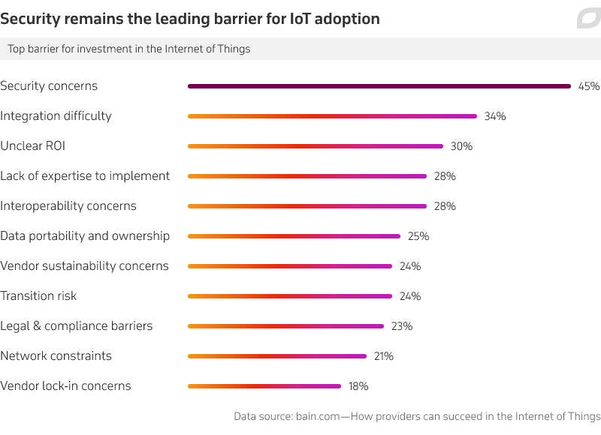

Slide 15
Future of IoT (CO2)
IOT is accepted to change the whole way individuals convey, work and live. Presently there will be availability for everybody, everything and all over the place. It will influentially affect how the organizations and government associate with the world.
According to NASSCOM, the global market size of IOT is expected to touch USD 3 trillion by 2020.
In India, nearly 120 companies and 70 % start-ups are offering IOT enabled solutions. From 2015 till now, around 60 USD million has been invested in IOT which has given birth to a new way of working and living.
The shift towards IOT will result in more improved and efficient businesses. Use of IOT enabled devices will make enterprises adopt better technology in their businesses.
From Logistic industry to IT industry, IOT will have a crucial role to play in the development of these sectors. Adoption of IOT will help businesses in saving costs at greater margins.
IoT considers ongoing data that we've never had. We can screen our homes and organizations remotely to keep them secure. Organizations can improve effectiveness, increment efficiency, and decrease cost. This is an exceptional open door for them to transform information into noteworthy bits of knowledge. IoT keen sensors can screen changing natural conditions and caution us of looming fiascos. With IoT, potential outcomes are interminable.

Slide 16
Different Definitions of IoT (CO1)
1. The term IoT, or Internet of Things, refers to the collective network of connected devices and the technology that facilitates communication between devices and the cloud, as well as between the devices themselves.
2. The internet of things (IoT) is a set of technologies that uses sensors and actuators to inform us about the status of everyday items such as vehicles, tools and even living beings. It allows us to interact with them, enabling connectivity with platforms in the cloud that receive and process information for posterior analysis. This analyzed data is then used to make decisions.
3. The Internet of Things (IoT) is a computing concept that describes the idea of everyday physical objects being connected to the internet and being able to identify themselves to other devices and send and receive data.
4. The Internet of Things, also called The Internet of Objects, refers to wireless network between objects, usually the network
will be wireless and self-configuring, such as household appliances. (Wikipedia).
5. The term "Internet of Things” has come to describe a number of technologies and research disciplines that enable the Internet to reach out into the real world of physical objects. (IoT 2008).
6. The Internet of Things (IoT) refers to a vast number of "things" that are connected to the internet so they can share data with other things — IoT applications, connected devices, industrial machines and more. Internet-connected devices use built-in sensors to collect data and, in some cases, act on it. IoT connected devices and machines can improve how we work and live. Real-world Internet of Things examples range from a smart home that automatically adjusts heating and lighting to a smart factory that monitors industrial machines to look for problems, then automatically adjusts to avoid failures.(2020)

Slide 17
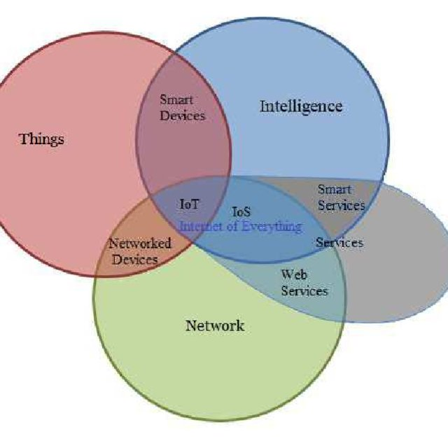
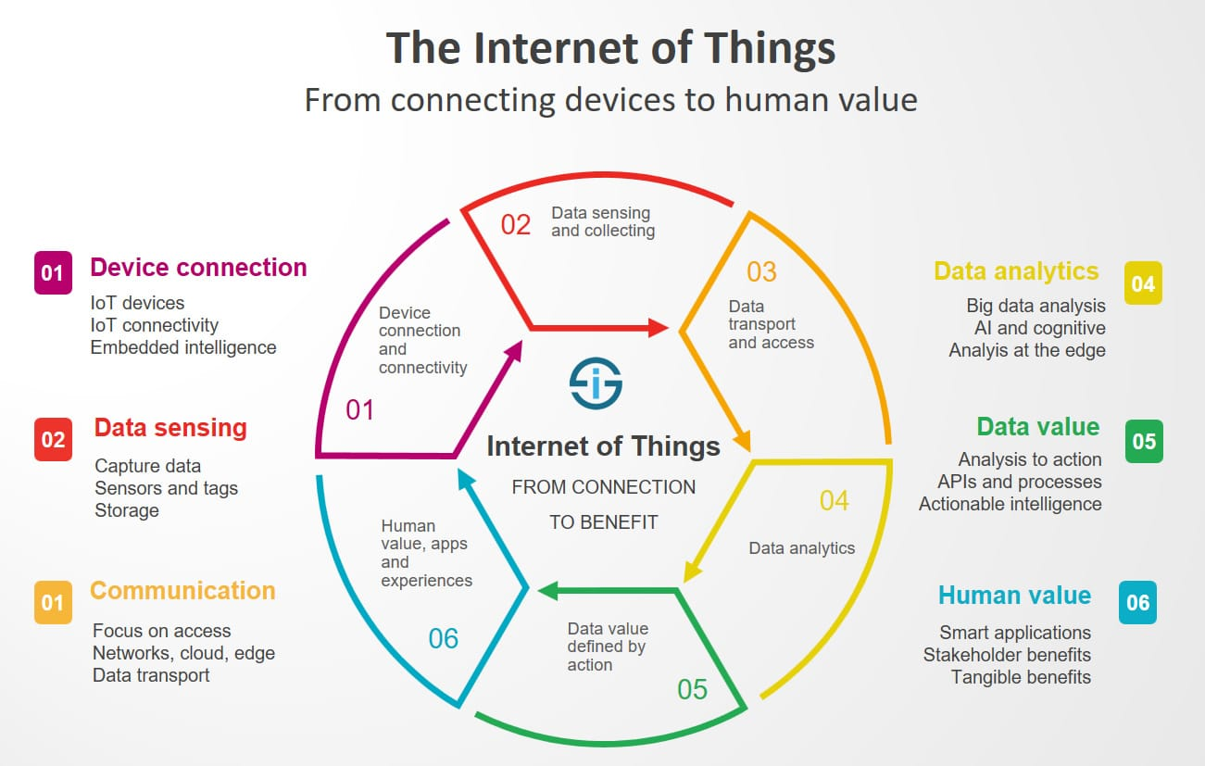
Similar Concepts of IoT (CO1)

Slide 18
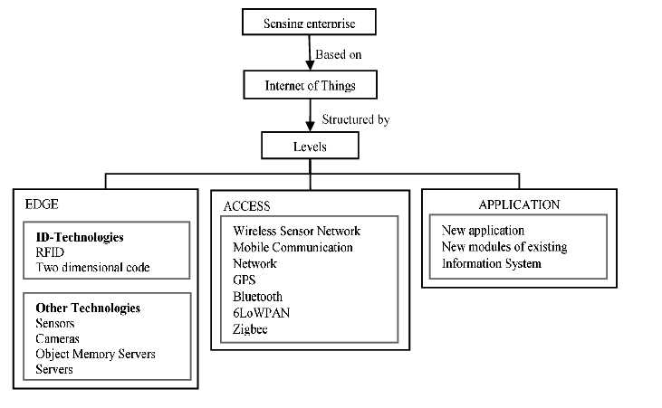

Slide 19
Sensing (CO3)
A device that provides a usable output in response to a specified measurement. The sensor attains a physical parameter and converts it into a signal suitable for processing (e.g. electrical, mechanical, optical) the characteristics of any device or material to detect the presence of a particular physical quantity.
The common IoT sensors that will be employed include:
1. Temperature sensors
2. Pressure sensors
3. Motion sensors
4. Level sensors
5. Image sensors
6. Proximity sensors
7. Water quality sensors
8. Chemical sensors
9. Gas sensors
10. Smoke sensors
11. Infrared (IR) sensors
12. Acceleration sensors
13. Gyroscopic sensors
14. Humidity sensors
15. Optical sensors

Slide 20
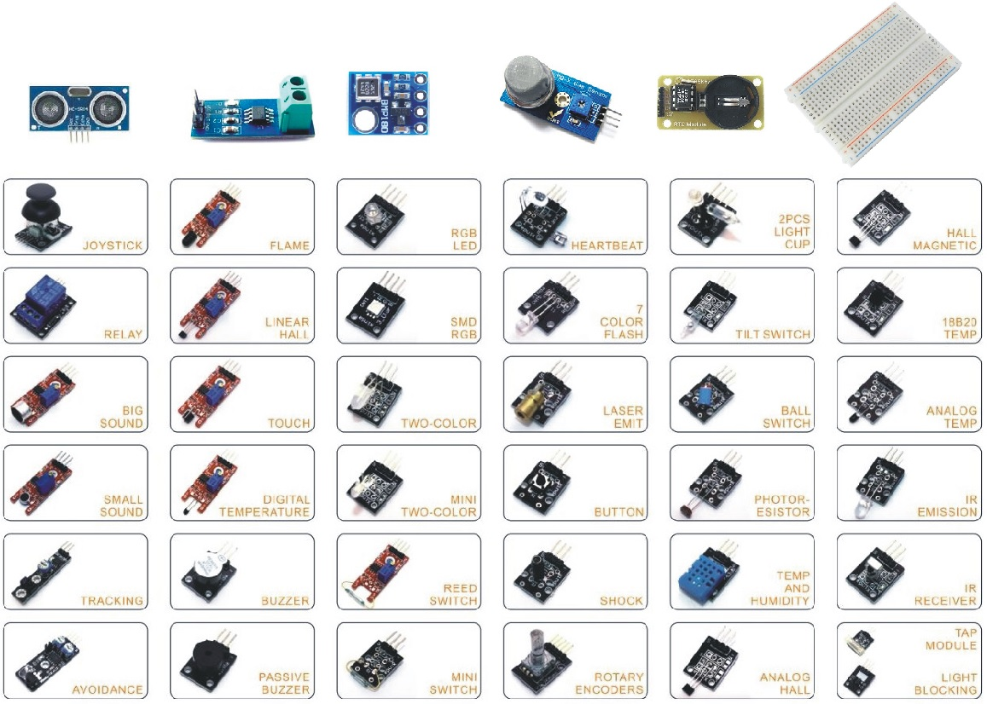

Slide 21
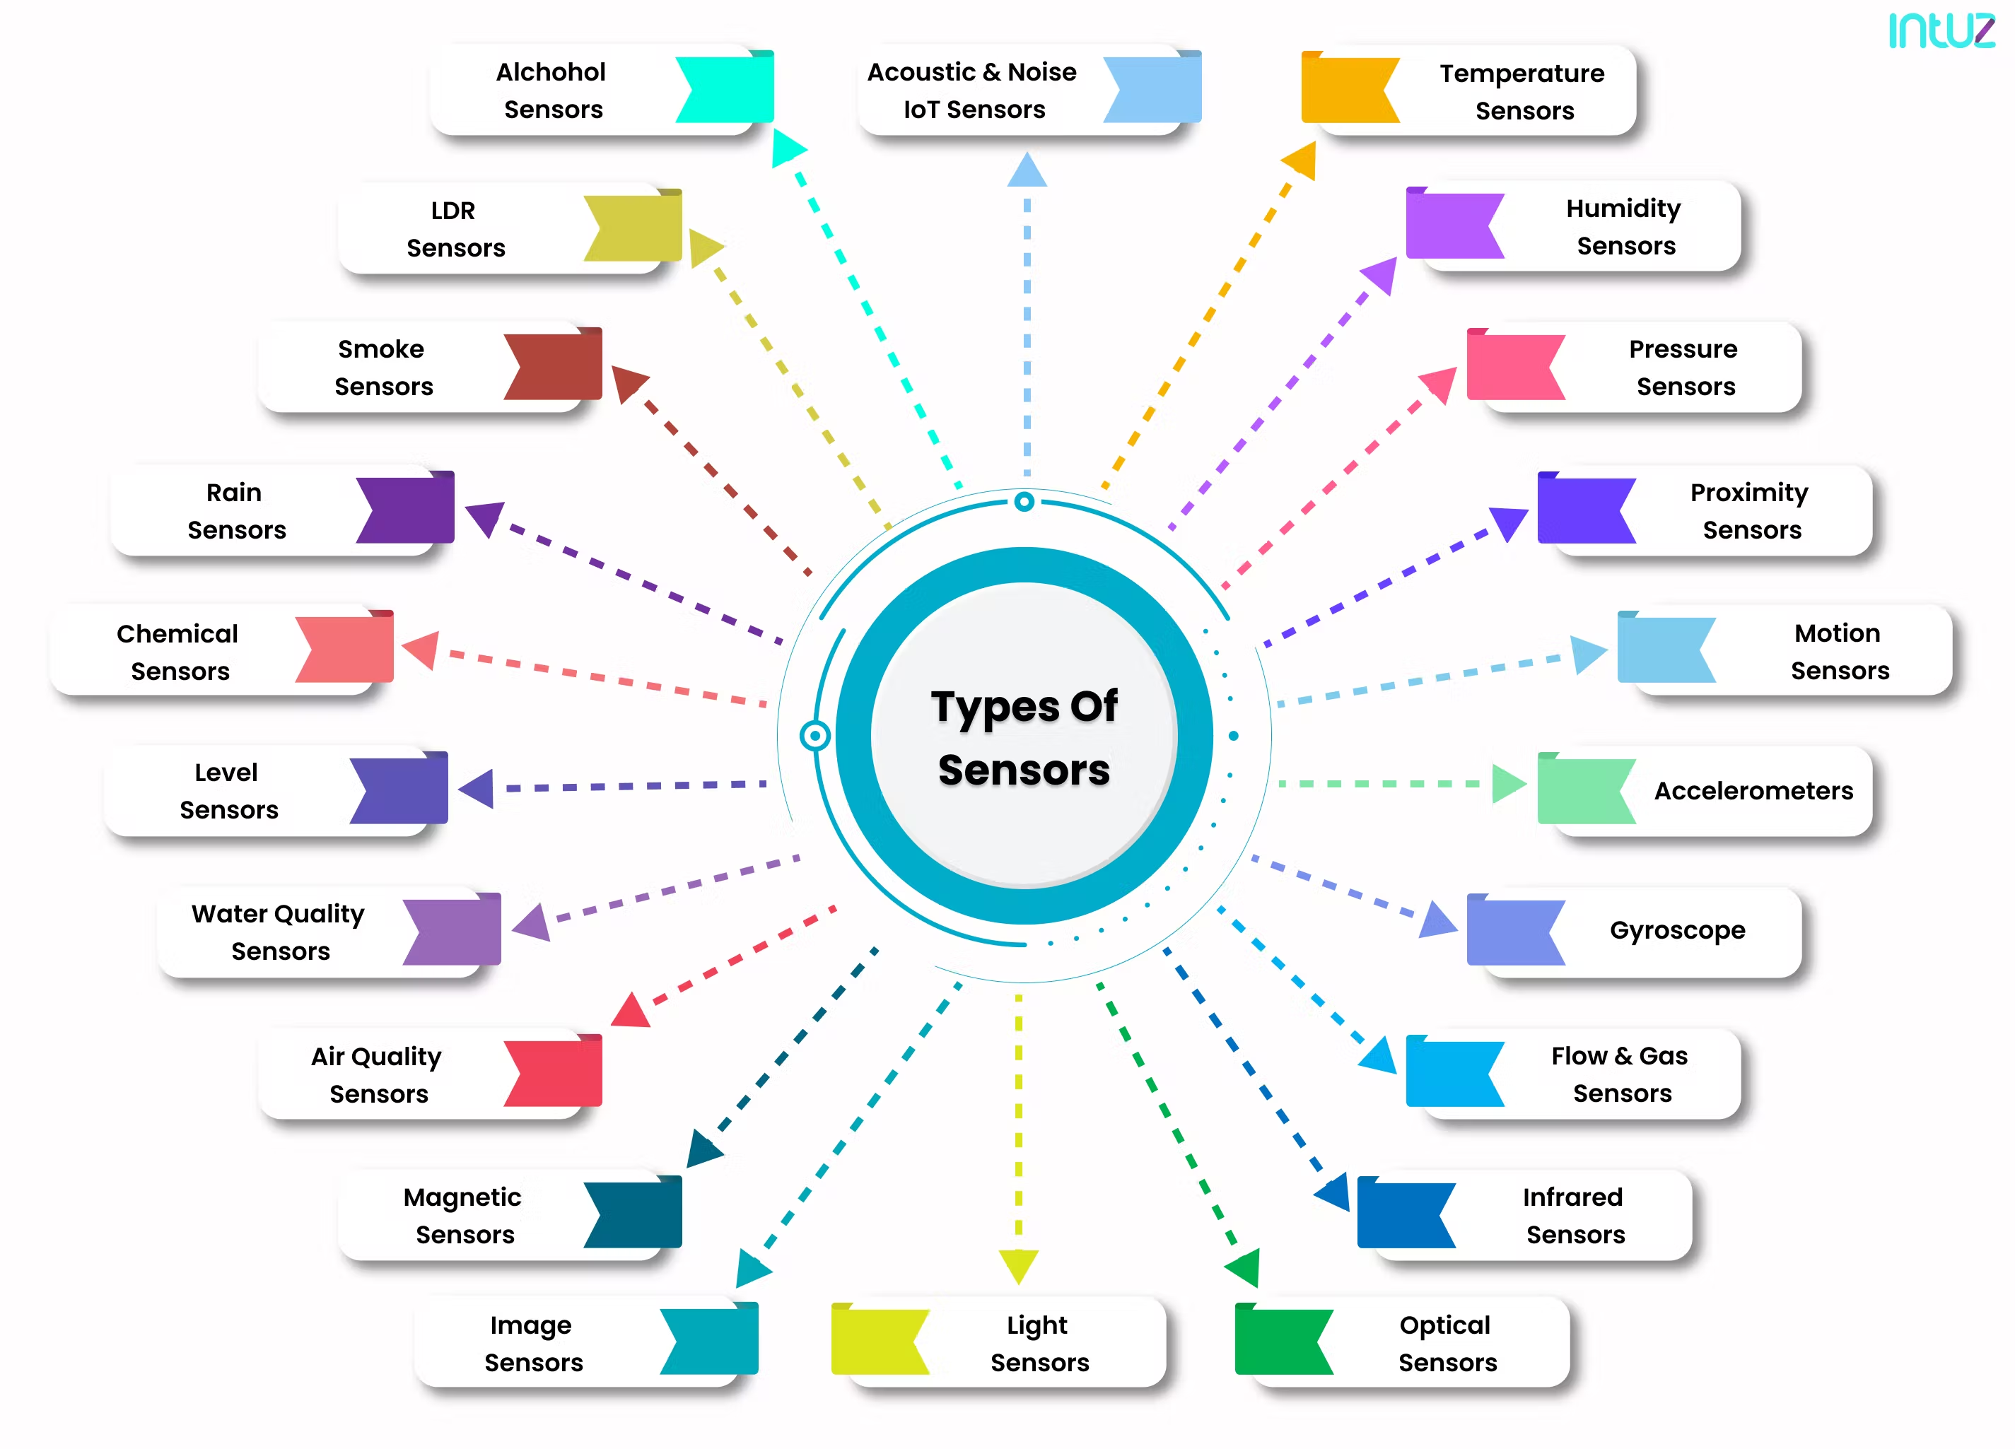

Slide 22
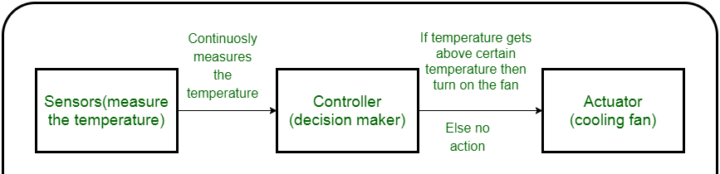
Actuation (CO-3)
An actuator is a machine component or system that moves or controls the mechanism of the system. Sensors in the device sense the environment, then control signals are generated for the actuators according to the actions needed to perform.
Types of Actuators :
Hydraulic Actuators
Pneumatic Actuators
Electrical Actuators
Thermal/Magnetic Actuators
Mechanical Actuators

Slide 23
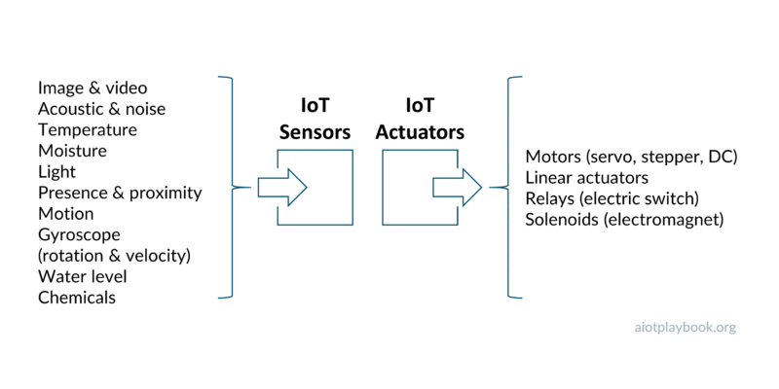

Slide 24
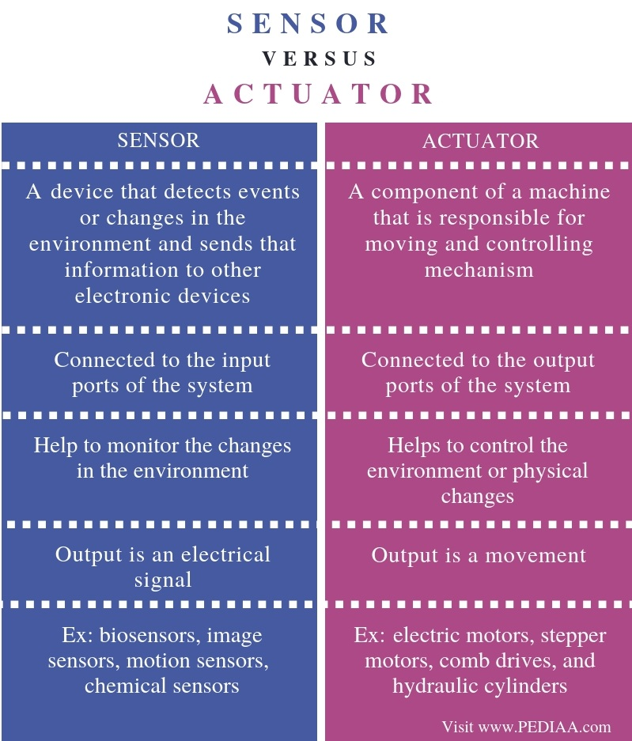
Sensors & Actuators (CO-3)

Slide 25
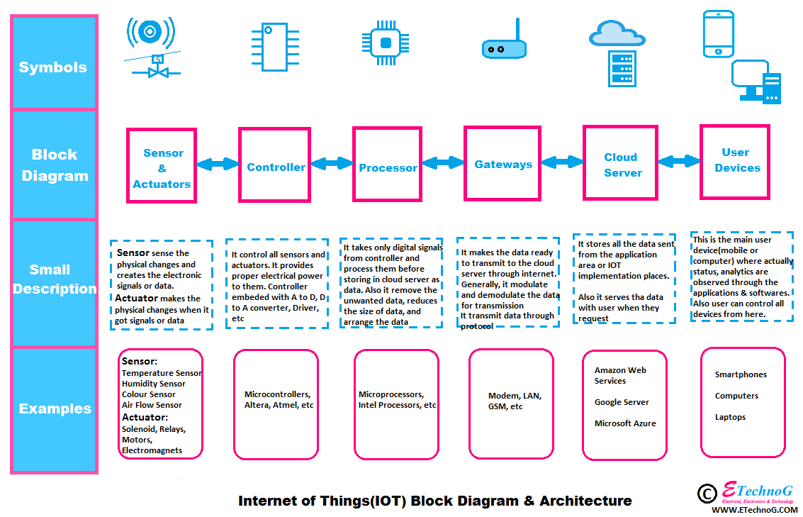

Slide 26
Smart Objects (CO-3)
The concept of smart in IoT is used for physical objects that are active, digital, networked, can operate to some extent autonomously, reconfigurable and has local control of the resources. The smart objects need energy, data storage, etc.
A smart object is an object that enhances the interaction with other smart objects as well as with people also. The world of IoT is the network of interconnected heterogeneous objects (such as smart devices, smart objects, sensors, actuators, RFID, embedded computers, etc.) uniquely addressable and based on standard communication protocols.
In a day to day life, people have a lot of object with internet or wireless or wired connection. Such as:
1. Smartphone
2. Tablets
3. TV computer
These objects can be interconnected among them and facilitate our daily life (smart home, smart cities) no matter the situation, localization, accessibility to a sensor, size, scenario or the risk of danger.

Slide 27
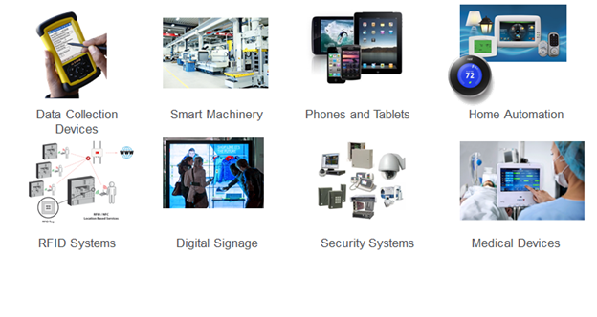

Slide 28
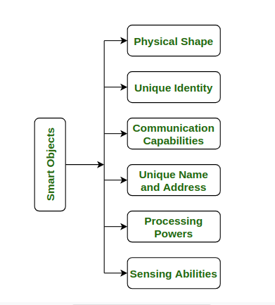
Capabilities required in every smart Objects

Slide 29
Smart Applications (CO-2)
Smart Apps are innovative systems that gather tremendous amounts of data from sensors and other sources, using machine learning algorithms and predictive analytics to make this information actionable for users and to improve experiences. Unlike their predecessors they are:
Intelligent – Smart Apps use analytics, machine learning and AI services to make recommendations and predictions that guide users and things to take the next best action.
2. Contextual – Using personal, sensor and location data, Smart Apps are personalized, embedded in users’ processes and available on any channel/device.
3. Proactive – Smart Apps come to the user versus the other way around, leveraging push notifications, chat bots and messaging services to proactively interact with users and give them smart recommendations of what to do and when.

Slide 30
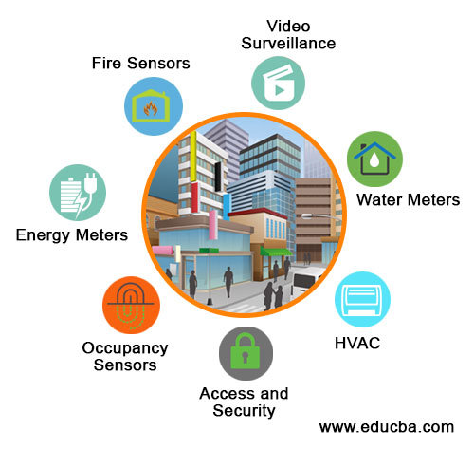

Slide 31
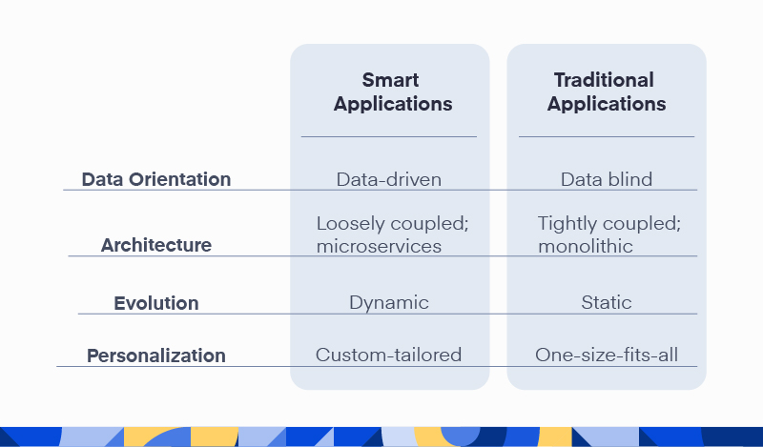

Slide 32
Summary
The Internet of Things (IoT) unites physical objects with the virtual world. Smart devices and machines are connected to each other and the Internet. They capture information about their direct environment with the aid of sensors, then analyze and link it and make it available in a network.
IoT − Advantages
Improved Customer Engagement − Current analytics suffer from blind-spots and significant flaws in accuracy; and as noted, engagement remains passive. IoT completely transforms this to achieve richer and more effective engagement with audiences.
Technology Optimization − The same technologies and data which improve the customer experience also improve device use, and aid in more potent improvements to technology. IoT unlocks a world of critical functional and field data.
Reduced Waste − IoT makes areas of improvement clear. Current analytics give us superficial insight, but IoT provides real-world information leading to more effective management of resources.
Enhanced Data Collection − Modern data collection suffers from its limitations and its design for passive use. IoT breaks it out of those spaces, and places it exactly where humans really want to go to analyze our world. It allows an accurate picture of everything.
IoT − Disadvantages
Security − IoT creates an ecosystem of constantly connected devices communicating over networks. The system offers little control despite any security measures. This leaves users exposed to various kinds of attackers.
Privacy − The sophistication of IoT provides substantial personal data in extreme detail without the user's active participation.
Complexity − Some find IoT systems complicated in terms of design, deployment, and maintenance given their use of multiple technologies and a large set of new enabling technologies.
Flexibility − Many are concerned about the flexibility of an IoT system to integrate easily with another. They worry about finding themselves with several conflicting or locked systems.
Compliance − IoT, like any other technology in the realm of business, must comply with regulations. Its complexity makes the issue of compliance seem incredibly challenging when many consider standard software compliance a battle.

Slide 33
QUIZ
1. Which is not an IoT platform?
(A) Xiaomi Cloud (B) Google Cloud (C) Myntra (D) AWS-Amazon Web Services
2. The main purpose of the web of things (WoT) in IoT is:
(A) to increase the cost (B) to improve security (C) to improve the usability and interoperability (D) All of these
3. A _____ is the component that executes a program in an IoT system.
(A) micro converter (B) Microcontroller (C) micro sensor (D) None
4. Who coined the term “Internet of Things”?
Kevin Aston (B) John Wright (C) Edward Jameson (D) George Garton
5. When was the actual term “Internet of Things” coined?
1998 (B) 1999 (C) 2000 (D) 2002
6. Which of the following is not an IoT device?
Table (B) Laptop (C) Arduino (D) Tablet
7. Which of the following is not a fundamental component of an IoT system?
Sensors (B) Connectivity and data processing (C) User interface (D) Transformer

Slide 34
REFERENCES
TEXT BOOKS
Ovidiu Vermesan, Peter Friess, “Internet of Things-Converging Technologies for Smart Environments & integrated Ecosystem”, River Publications Netherlands.
Internet Society, “An overview of Internet of Things”.
IoT Fundamentals: Networking Technologies, Protocols, and Use Cases for the Internet of Things by David Hanes, Gonzalo Salgueiro, Patrick Grossetete, CISO Press.
REFERENCE BOOKS
Pfister, Cuno, “Getting started with the Internet of Things: connecting sensors and microcontrollers to the cloud", O'Reilly Media, Inc.”, 2011.
Greenfield, Adam,” Everyware: The dawning age of ubiquitous computing”, New Riders, 2010.
The Internet of Things, revised and updated edition (The MIT Press Essential Knowledge series) by Samuel Greengard, MIT Press.
Video Links
https://www.youtube.com/playlist?list=PLaxu2gn-9WXMf_ln5pMvxjf043jzof4-i
Web Links
https://www.the-reference.com/en/expertise/creation-and-implementation/internet-of-things
https://www.lifewire.com/introduction-to-the-internet-of-things-817766
Https://onlinecourses.nptel.ac.in/noc17_cs22/preview
https://www.intel.com/content/www/us/en/technology-provider/training/intro-to-iot.html

Slide 35
THANK YOU

